Slide 1
BATTLESHIP
the ultimate war
A Presentation
By
Saikot Das Joy
(from Builders group)
https://www.google.com/url?sa=i&url=https%3A%2F%2Fstore.steampowered.com%2Fapp%2F764050%2FMaelstrom%2F&psig=AOvVaw2LDcD1fuahtTd6eeKO0vOX&ust=1625211275543000&source=images&cd=vfe&ved=0CAoQjRxqFwoTCNj9wIeuwfECFQAAAAAdAAAAABAD

Slide 3
How did I proceed to build the game?
Requirements analysis
Interface design and implementation
Logic Creation
Separately implementation of every feature and scope with pre defined logic
Combining with the main code
Verification and validation

Slide 4
Requirements Analysis
Main Requirements (Everything has to be implemented By C code only):
Two person game
Playing field
Square of 10 x 10
The horizontal boxes are identified with numbers 1-10.
The vertical boxes are marked with letters a – j.
Ships
Total: 10 Ships
4 ships over 2 boxes, 3 ships over 3 boxes, 2 ships over 4 boxes, 1 ship over 5 boxes
The ships are placed either horizontally or vertically
Must remain in a line (not around a corner)
At least one box must remain between the ships

Slide 5
Requirements Analysis
Rules:
Played in turns
If a player has hit a piece of a ship, he may guess again. As soon as all pieces of a ship have been found, one says "sunk".
The player names a field on the game board. The fields result from the crossing points of the letters and numbers, e.g. G5.
The game continues until one of the two players has found or "sunk" all of his opponent's ships.
Requierements:
One player game (Computer with at least two difficulty levels)
Two player game

Slide 6
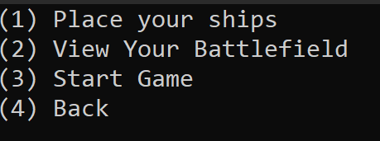
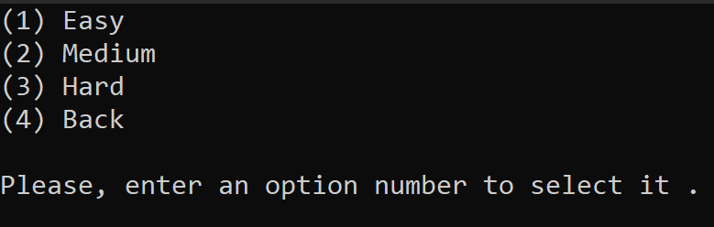
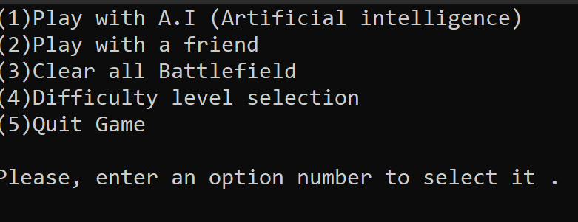
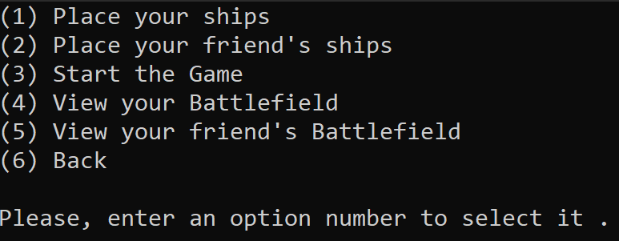
(1)
(4)
(4)
(4)
(6)
(2)

Slide 7
Logic (Battlefield Creation)
2D Array of size [12][12] is used for each Battlefield
0 1 2 3 4 5 6 7 8 9 10 11 => y
x <=
 | 0 | 1 | 2 | 3 | 4 | 5 | 6 | 7 | 8 | 9
a | . | . | . | . | . | . | . | . | . | .
b | . | . | . | . | . | . | . | . | . | .
c | . | . | . | . | . | . | . | . | . | .
d | . | . | . | . | . | . | . | . | . | .
e | . | . | . | . | . | . | . | . | . | .
f | . | . | . | . | . | . | . | . | . | .
g | . | . | . | . | . | . | . | . | . | .
h | . | . | . | . | . | . | . | . | . | .
i | . | . | . | . | . | . | . | . | . | .
j | . | . | . | . | . | . | . | . | . | .
User’s input(suppose q) for column is replaced by y=q+1
and raw input as a,b,c,d,e,f,g,h,I,j is replaced by x values ( 1,2,3,4,5,6,7,8,9,10) in code for further operation during implementation
0 1 2 3 4 5 6 7 8 9 10 11

Slide 8
Logic (Ship Placement By User)
0 1 2 3 4 5 6 7 8 9 10 11 => y
x <=
 | 0 | 1 | 2 | 3 | 4 | 5 | 6 | 7 | 8 | 9
a | . | . | . | . | . | . | . | . | . | O
b | . | . | . | . | . | . | . | . | . | O
c | . | . | . | . | . | . | . | . | . | .
d | . | . | . | . | . | . | . | . | . | .
e | . | . | . | O | O | O | . | . | . | .
f | . | . | . | . | . | . | . | . | . | .
g | . | . | . | . | . | . | . | . | . | .
h | O | O | . | . | . | . | . | . | . | .
i | . | . | . | . | . | . | . | . | . | .
j | . | . | . | . | . | . | . | . | . | .
Every time User places a ship , there is a conditional placement check in the code so that user can’t place his ship in invalid location. If user’s give invalid input, it warns user about that and asks to re-try
Counter variable is used to limit ship placements of different types
0 1 2 3 4 5 6 7 8 9 10 11

Slide 9
Logic (Ship Placement By A.I)
 | 0 | 1 | 2 | 3 | 4 | 5 | 6 | 7 | 8 | 9
a | . | . | . | . | . | . | . | O | . | .
b | O | O | . | O | . | . | . | O | . | .
c | . | . | . | O | . | . | . | O | . | .
d | O | O | . | O | . | O | . | . | . | .
e | . | . | . | O | . | O | . | . | . | .
f | O | O | . | O | . | O | . | O | O | O
g | . | . | . | . | . | . | . | . | . | .
h | O | O | O | O | . | O | O | O | O | .
i | . | . | . | . | . | . | . | . | . | .
j | O | O | . | . | . | . | . | . | . | .
5 Battlefields array like this
with different ship placements
were declared.
Random number generator
generates numbers 1-5 and
according to this number
randomely a battlefield is
selected and copied to
an array U[12][12]
Further gameplay is coded
with this array U[12][12]

Slide 10
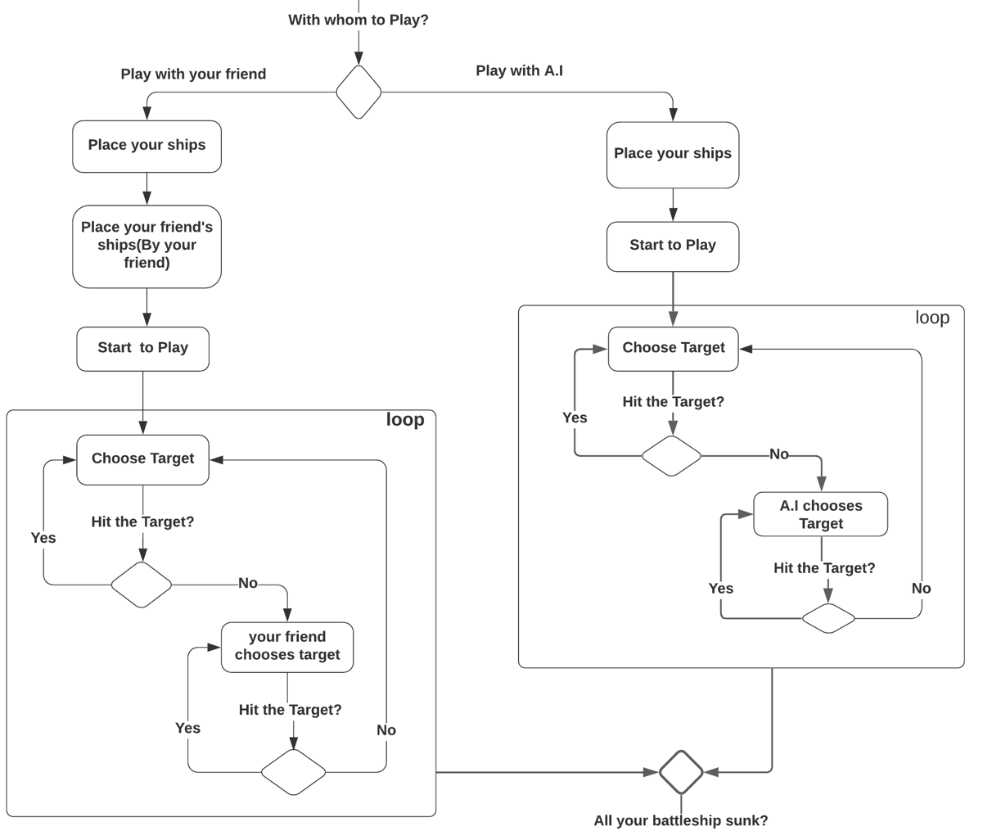
Logic (Gameplay)
At first User clears all pre-input data with the option “Clear”
Then playing starts either with the A.I or with another friend according to this
which is a part of the activity
diagram I made for this
project.

Slide 11
Logic (Gameplay)
When User gives target position, Program checks in the opponent’s battle either there is a ship part or not. If yes it replaces (O) by (.)
and says “Attack Successful”
and gives the chance to
attack again .
If No, Opponent gets the
chance to attack
It also checks The attack position and its surrending´s. If there is no “O” that means ship’s part on it’s surrending,
It says “One opponent ship
is “Sunk” and counts it.
 | 0 | 1 | 2 | 3 | 4 | 5 | 6 | 7 | 8 | 9
a | . | . | . | . | . | . | . | O | . | .
b | O | O | . | O(.) | . | . | . | O | . | .
c | . | . | . | O | . | . | . | O | . | .
d | O | O | . | O | . | O | . | . | . | .
e | . | . | . | O | . | O | . | . | . | .
f | O | O | . | O | . | O | . | O | O | O
g | . | . | . | . | . | . | . | . | . | .
h | O | O | O | O | . | O | O | O | O | .
i | . | . | . | . | . | . | . | . | . | .
j | O(.) | . | . | . | . | . | . | . | . | .
For A.I attack part, it generates numbers between 1-10 for raw
and column.
Who destroys all of the opponent ships 1st wins the game.

Slide 12
Further explanation will be explained from the Codes
…… .….. …… .….. ……

Slide 13

https://images-eu.ssl-images-amazon.com/images/I/71+va3xTXDL._AC_UL600_SR600,600_.jpg

